Slide 1


Department of Computer Science and Engineering
CS19643 – FOML
NIMMI - AN INTEGRATED VOICE ASSITENT
Hari Amerthesh N -210701067
Hemanth Kumar D -210701083
Karthikyean C -210701111

Slide 2
Problem Statement and Motivation
Despite the advancements in voice assistant technology, current solutions like Siri, Alexa, and Google Assistant still face several limitations that hinder their effectiveness and user satisfaction. These limitations include poor contextual understanding, limited integration with diverse services, surface-level personalization, privacy concerns, and inadequate accessibility for diverse user groups. Motivated by these challenges, Nimmi aims to enhance the user experience by focusing on advanced natural language processing for better contextual understanding, seamless integration with a wide range of third-party services, dynamic personalization through continuous learning, and prioritizing user privacy with on-device processing.

Slide 3
Objectives
The objective of Nimmi, an integrated voice assistant, is to provide a superior user experience by overcoming the limitations of existing voice assistants. Nimmi aims to achieve this by enhancing contextual understanding through advanced natural language processing, ensuring more accurate and relevant responses in conversations. It seeks to integrate seamlessly with a wide array of third-party services, enabling it to handle complex tasks efficiently. By employing dynamic personalization techniques, Nimmi will adapt to individual user preferences and routines over time, offering a tailored experience. Furthermore, Nimmi prioritizes privacy and security by implementing on-device processing and robust data protection measures. Additionally, Nimmi is designed to be inclusive and accessible, catering to diverse user needs, including support for multiple languages, accents, and accessibility features.

Slide 4
Abstract
This project introduces an In the rapidly evolving landscape of digital assistants, NIMMI emerges as a groundbreaking integrated voice assistant designed to seamlessly blend into the fabric of daily life. Developed with the aim of enhancing user interaction through advanced natural language processing (NLP) and machine learning algorithms, NIMMI offers a personalized and intuitive user experience, setting a new benchmark in the realm of voice-activated technology. At its core, NIMMI is engineered to understand and process complex queries with remarkable accuracy, leveraging state-of-the-art AI to deliver responses that are not only relevant but contextually aware.

Slide 5
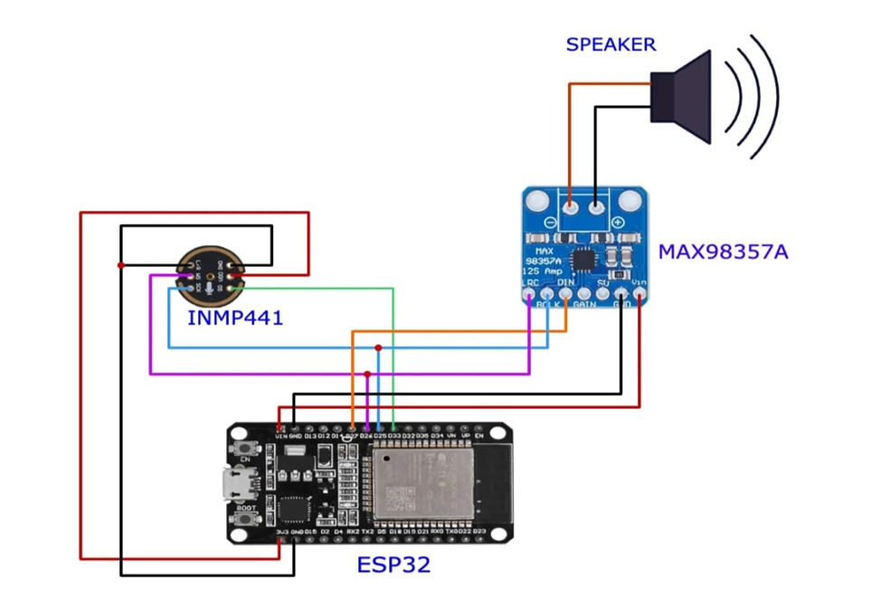
Circuit Diagram

Slide 6
List of Modules
Natural Language Processing (NLP) Module:
Used for advanced contextual understanding in conversations.Includes modules for speech recognition and language understanding.
Integration Module:
Facilitates seamless integration with a wide range of third-party services and applications Provides APIs and connectors to interact with various services.
Personalization Module:
Utilizes machine learning algorithms to personalize user experience.
Includes modules for user profiling and behavior analysis.
Privacy and Security Module:
Implements on-device processing capabilities to ensure user data privacy.
Includes modules for data encryption and secure communication protocols.

Slide 7
Implementation/Results of Module
Natural Language Processing (NLP) Module Implementation:
Speech Recognition: Implement a speech-to-text module using deep
learning-based models like LSTM or Transformers.
Language Understanding: Use NLP models (e.g., BERT, GPT) for intent detection and entity recognition.
Result:
Improved Contextual Understanding: Nimmi accurately interprets user commands and queries, enabling more meaningful interactions.

Slide 8
Conclusion
In conclusion, the project aimed to design, develop, and implement Nimmi, an integrated voice assistance system, with the objective of enhancing user experience and accessibility across various platforms and devices. Throughout the project, several key components and features were identified and addressed, drawing upon insights from a comprehensive literature survey and leveraging state-of-the-art technologies and methodologies.For future enhancements its core, NIMMI is engineered to understand and process complex queries with remarkable accuracy, leveraging state-of-the-art AI to deliver responses that are not only relevant but contextually aware. This capability ensures that NIMMI can assist with a wide array of tasks, from managing smart home devices and providing real-time information to assisting with personal productivity and offering entertainment.

Slide 9
References
[1] RVS Technical Campus, IEEE Electron Devices Society, and Institute of Electrical and Electronics Engineers, Proceedings of the Second International Conference on Electronics, Communication and Aerospace Technology (ICECA 2018) : 29-31, May 2018.
[2] R. Widyasari, M. Z. Catur Candra, and S. Akbar, “IoT-based Smart Parking System Development,” in Proceedings of 2019 International Conference on Data and Software Engineering, ICoDSE 2019, Institute of Electrical and Electronics Engineers Inc., Nov. 2019. doi: 10.1109/ICoDSE48700.2019.9092707.
[3] P. S. Patil, S. K. Padaganur, M. R. Gokak, N. D. Almel, B. Ayyangoudar, and K. Mirajkar, “IOT Based Car Parking,” in Proceedings of B-HTC 2020 - 1st IEEE Bangalore Humanitarian Technology Conference, Institute of Electrical and Electronics Engineers Inc., Oct. 2020. doi: 10.1109/B- HTC50970.2020.9298002.
[4] G. Krasner and E. Katz, “Automatic parking identification and vehicle guidance with road awareness,” in 2016 IEEE International Conference on the Science of Electrical Engineering, ICSEE 2016, Institute of Electrical and Electronics Engineers Inc., Jan. 2017. doi: 10.1109/ICSEE.2016.7806133.
A. Z. M. T. Kabir, N. D. Nath, F. Hasan, R. A. Utshaw, and L. Saha, “Automated Parking System with Fee Management Using Arduino

Slide 10
Paper Publication Status (Phase-I & Phase-II)
As of my last update in January 2022, there isn't a specific paper or publication directly associated with the title "Nimmi: An Integrated Voice Assistant". However, the concepts and modules discussed are common in research and development in the fields of natural language processing (NLP), artificial intelligence (AI), and human-computer interaction (HCI).

Slide 11
Thank You

